Slide 1
Persisting and Predicting Cryptocurrency Data
CSYE7200: Big Data Systems Engineering Using Scala
Team Number: 6
Varsha Premani
Aman Kapoor
Harshad Jaju

Slide 2





Methodology
We plan to develop a data pipeline to ingest, store, stream and analyse cryptocurrency transactional data (Bitcoin : BTC/USD) and predict the future prices
In order to ingest data, we plan to utilize REST API [Bitstamp API], this application is our batch layer used to ingest and parse the transactions from JSON to SPARK dataset
Batch Streaming and analysis will use kafka/Akka and zeppelin respectively (serialization, partitioning, structured streaming)

Slide 3



Use Cases
Rest API will fetch the data from cryptocurrency exchange and store in the parquet
Apache Zeppelin will query the application and perform the data analysis
Extract visualization reports, analyse and predict the future price of the bitcoin

Slide 4
Data Sources
The data is being fetched via an API from below URL https://www.bitstamp.net/api/
Since the URL is live, there is no fixed number of rows as of now but we can fetch the data based on our needs as by transaction made in the last minute, hour or even a day

Slide 5
Data Ingestion through REST API
Utilized Scala and Java SDK to call the endpoint
Import java.net.URL
import scala.io.Source val transactions = Source.fromURL(new URL("https://www.bitstamp.net/api/v2/transactions/btcusd/?time=hour")).mkString

Slide 6
Parsing the jSON response
Bitstamp endpoint yields a string containing a JSON array, and each element of the array is a JSON object that represents a transaction
case class HttpTransaction(date: String, tid: String, price: String, `type`: String, amount: String)
Unit Testing:
"BatchProducer.jsonToHttpTransaction" should { "create a Dataset[HttpTransaction] from a Json string" in { val json = """[{"date": "1532365695", "tid": "70683282", "price": "7740.00", "type": "0", "amount": "0.10041719"}, |{"date": "1532365693", "tid": "70683281", "price": "7739.99", "type": "0", "amount": "0.00148564"}]""".stripMargin val ds: Dataset[HttpTransaction] = BatchProducer.jsonToHttpTransactions(json) ds.collect() should contain theSameElementsAs Seq(httpTransaction1, httpTransaction2) } }

Slide 7
Saving transactions in parquet format
def unsafeSave(transactions: Dataset[Transaction], path: URI): Unit = transactions .write .mode(SaveMode.Append) .partitionBy("date") .parquet(path.toString)
The unsafe is to justify and state that the function has side effects as it is writing a file.

Slide 8
Batch Processing
Our BatchProducer application will work as follows:
On startup, fetch the last 24 hours of transactions. Set start = current day at midnight UTC and end = last transaction's timestamp.
Filter the transactions to only keep those between start and end and save them to Parquet.
Wait 59 minutes.
Fetch the last one hour of transactions.
We have a one minute overlap to make sure that we do not miss any transaction. Set the start = end and end = last transaction timestamps.
Go to step 2.

Slide 9
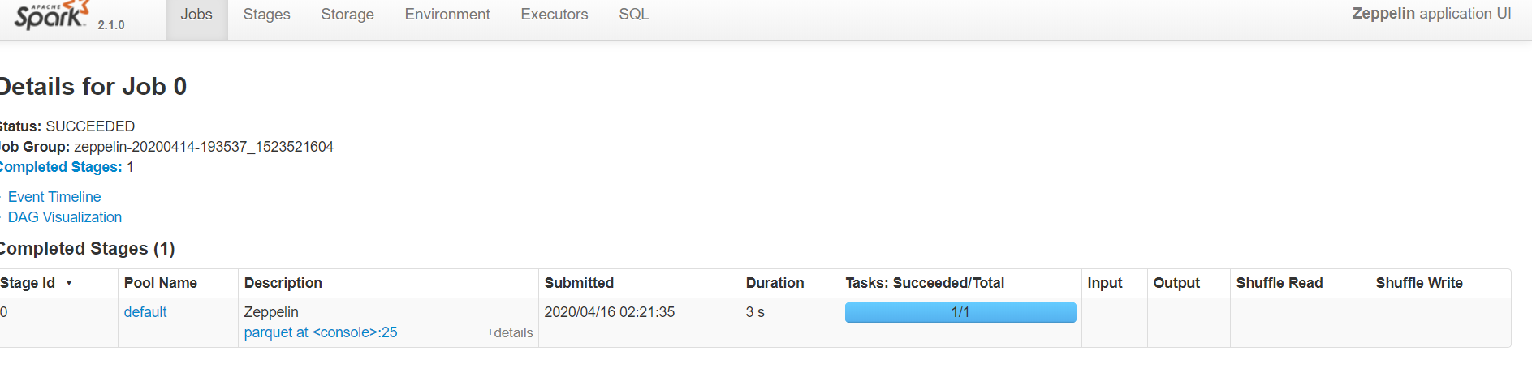
Executing application through Spark
Packaging the assembly JAR with dependencies and specification of Main class
Once we submit the jar through spark-submit and obtain the parquet generated output:
assemblyOption in assembly := (assemblyOption in assembly).value.copy(includeScala = false) test in assembly := {} mainClass in assembly := Some("coinyser.BatchProducerAppSpark")

Slide 10
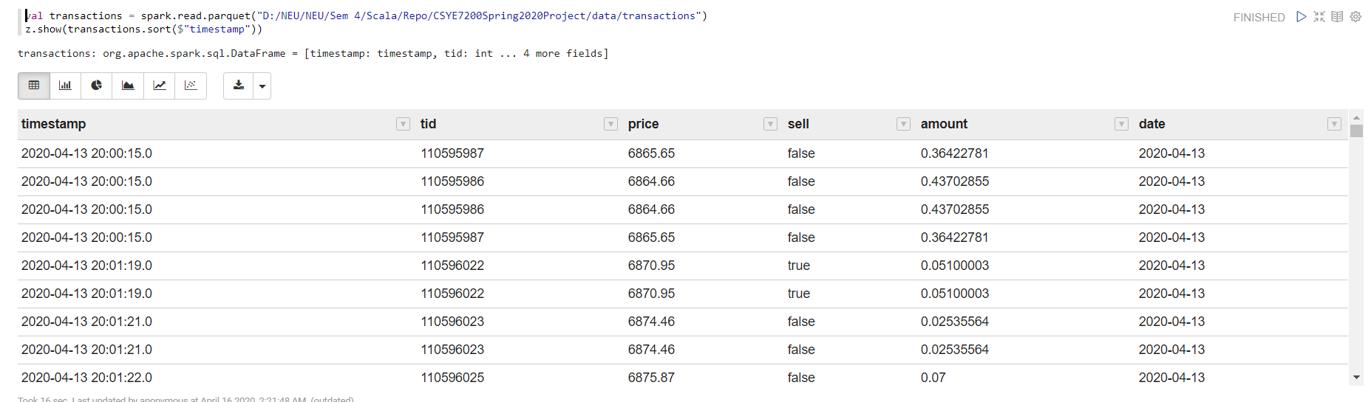
Transaction analysis through Zeppelin

Slide 11


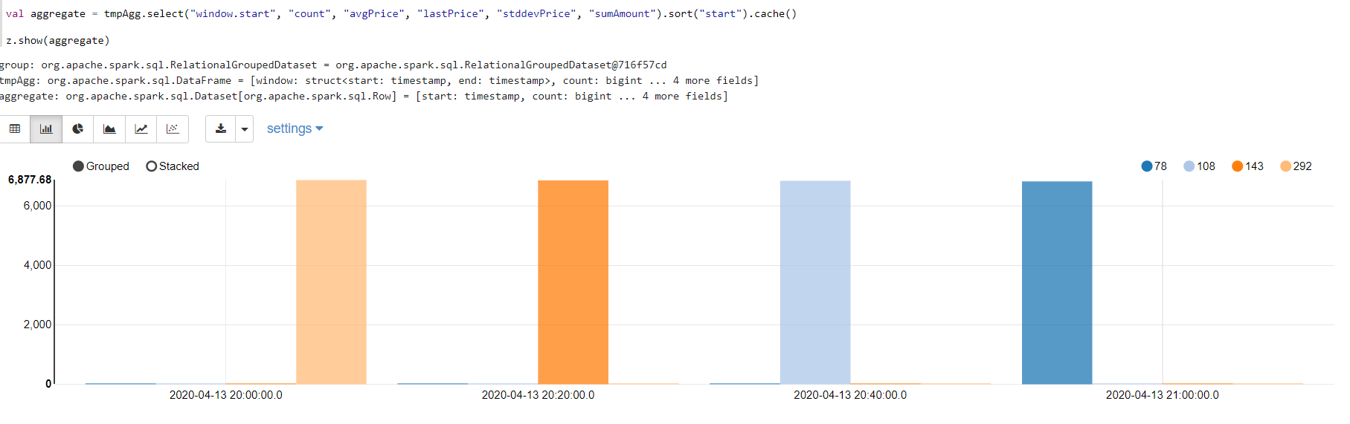


Average price of bitcoin transactions

Slide 12
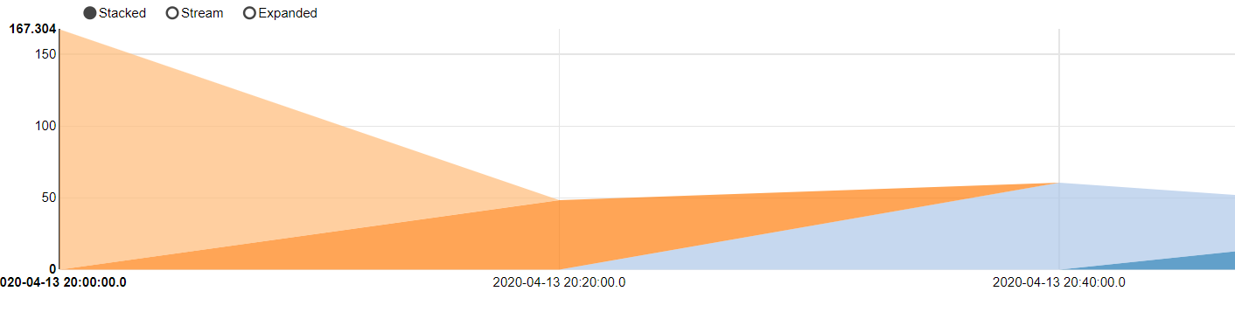
Transactions grouped by timestamp displaying the amount generated through transactions

Slide 13
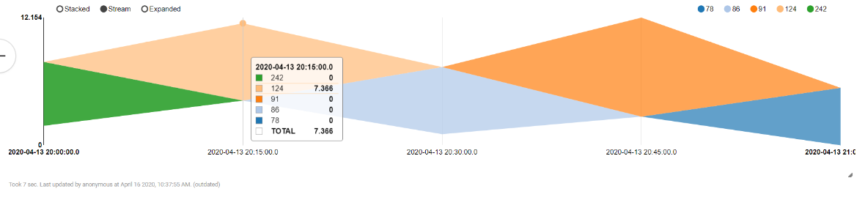
Standard deviation of prices at different time intervals

Slide 14
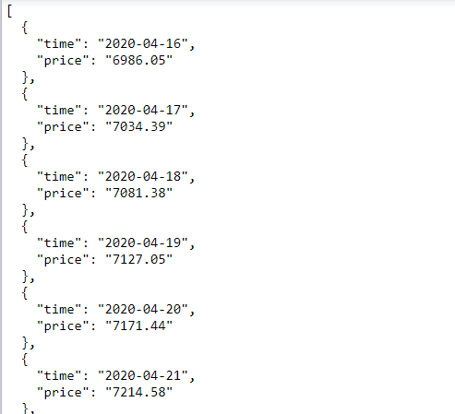
Price forecast for future
We utilize the stored data to obtain prediction for the future prices using ARIMA model.

Slide 15
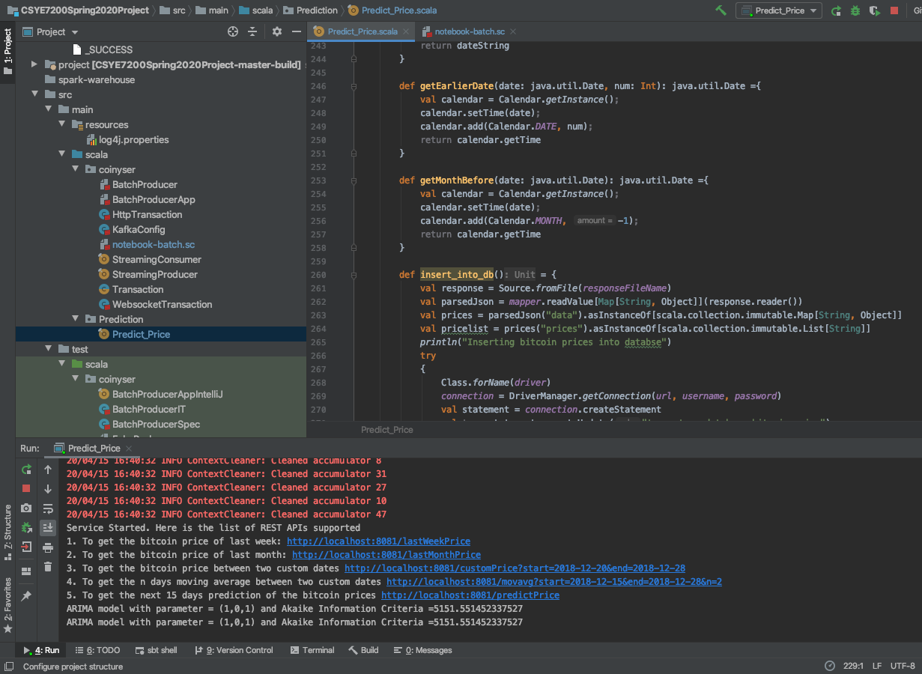
Using AIC to Test ARIMA Models
The Akaike Information Critera (AIC) is a widely used measure of a statistical model. It basically quantifies
1) the goodness of fit, and 2) the simplicity/parsimony, of the model into a single statistic.

Slide 16
Acceptance Criteria
90% of the data should be used for analysis - done
Being a time-series model for real-time data, achieve AIC to be less than 6000: Achieved AIC of 5151.55 and forecasted predictions for next 15 days.
Spark queries should be executed within 5- 10 seconds
Configuration criteria: Planning to set the retention policy to 3 minutes to avoid the disk space issue

Slide 17
Goals achieved
Our goal is to prepare an End-to-End big data storage platform for cryptocurrency exchange data and perform data analysis to detect a pattern in the bitcoin transaction and come up with a trading strategy: Created a data pipeline for analysing the exchange data and performed data analysis using Zeppelin
We are also going to predict the future prices of the Bitcoin: Forecasted the Bitcoin price for next 15 days

Slide 18
Code Repository
We’ll be using a group GitHub repository created under our official husky ids
All the code for API configuration, batch production and streaming will be done in Scala https://github.com/kapooraman22/CSYE7200Spring2020Project

